Slide 1



Slide 2



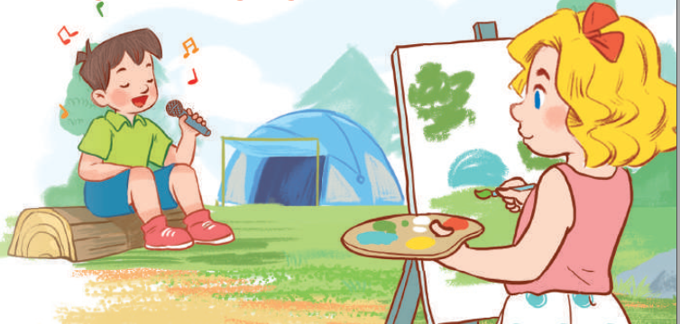
19
Outdoor activities
LESSON 1 – PERIOD 2

Slide 3
Warm-up
& Review
Listen
and tick.
Look,
complete
and read.
Let’s sing.
Fun corner
& wrap-up

Slide 4






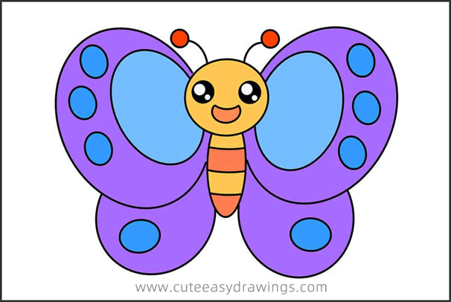




Slide 5

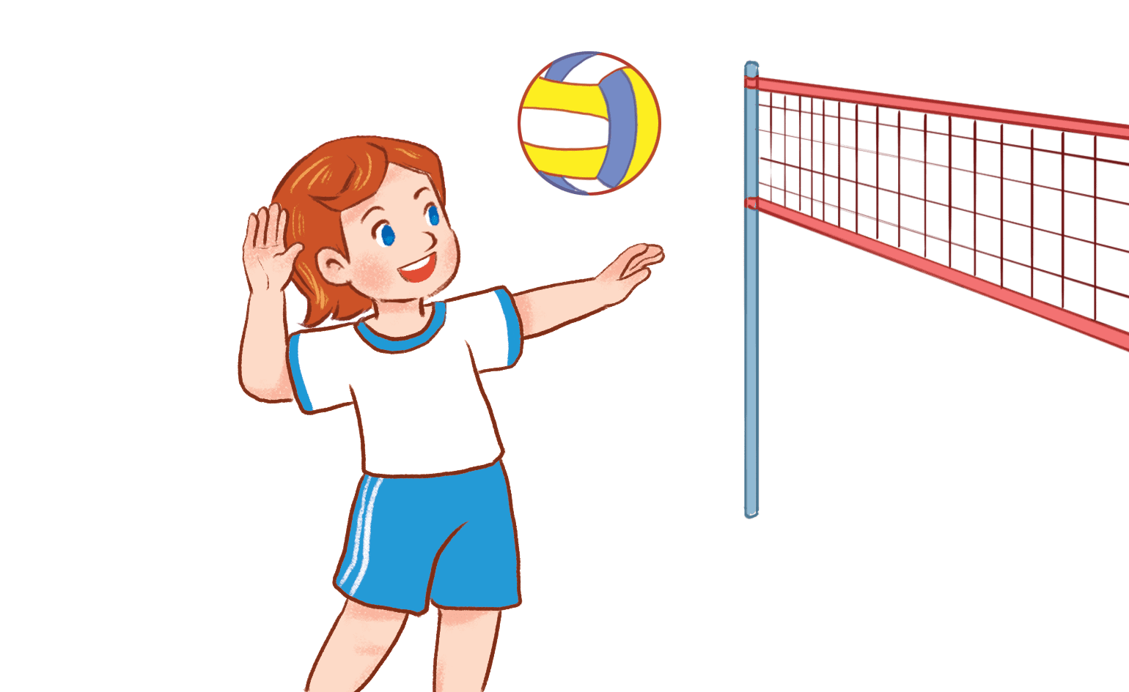


A. She’s playing badminton.
B. She’s playing basketball.
C. She’s playing volleyball.

Slide 6
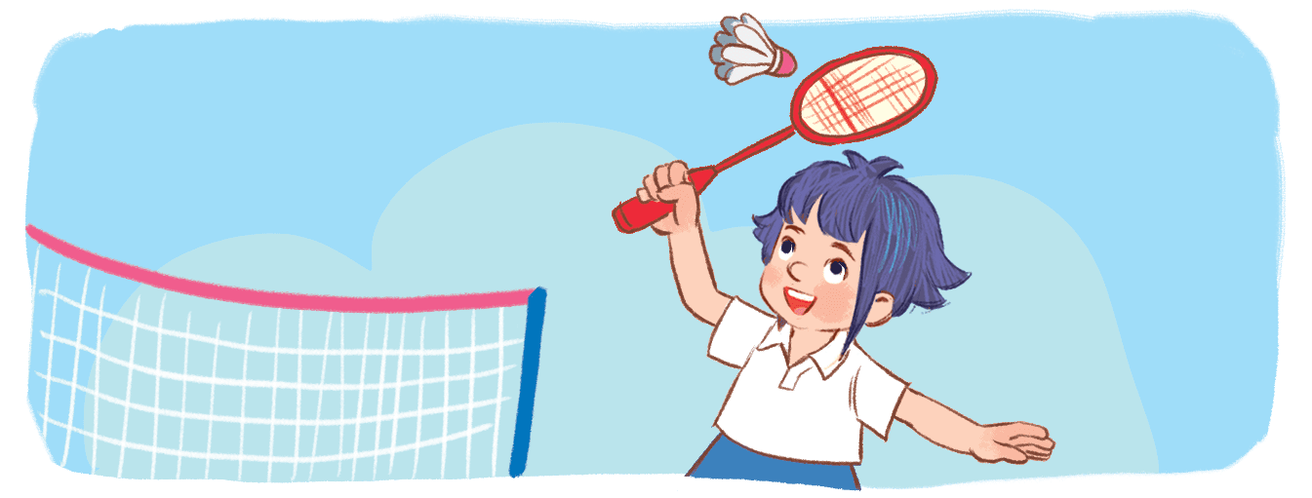
A. She’s playing badminton.
B. She’s playing basketball.
C. She’s playing volleyball.

Slide 7
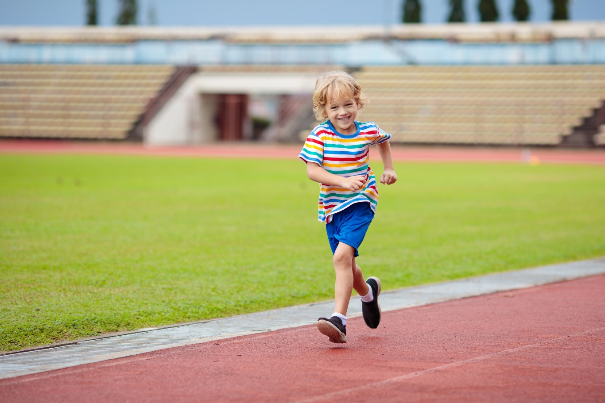
A. He’s walking.
B. He’s running.
C. He’s reading.

Slide 8
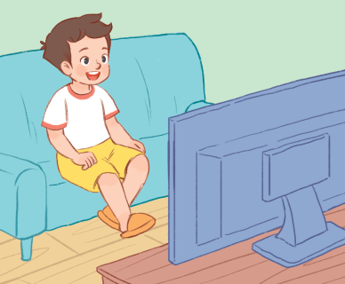
A. He’s listening to music.
B. He’s painting a picture.
C. He’s watching TV.

Slide 9
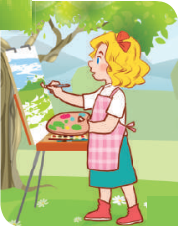
A. She’s painting a picture.
B. She’s listening to music.
C. She’s watching T.V.

Slide 10

A. She’s painting a picture.
B. She’s reading a book.
C. She’s watching TV.

Slide 11

A. She’s walking across the street.
B. She’s reading a book.
C. She’s running in the park.

Slide 12

A. He’s listening to music.
B. He’s singing a song.
C. He’s painting a picture.

Slide 13


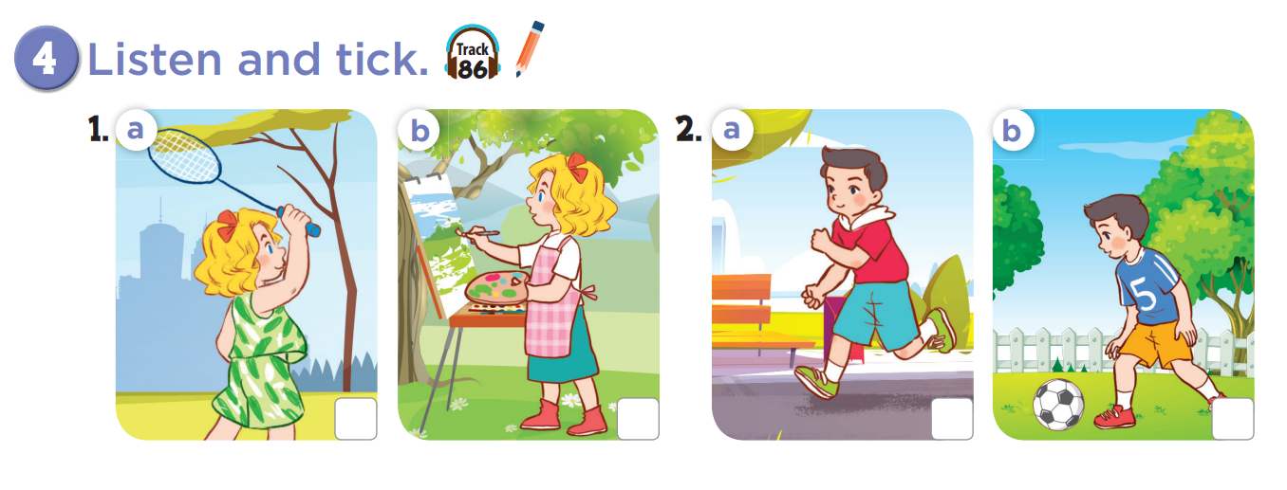
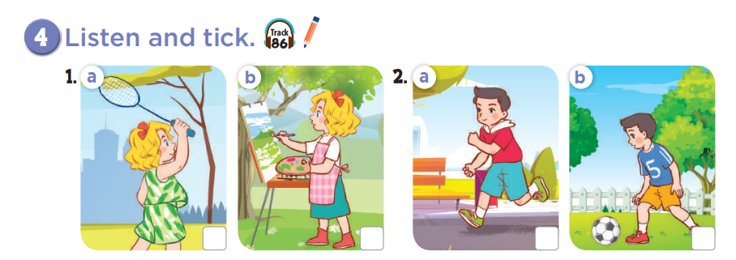


Slide 14
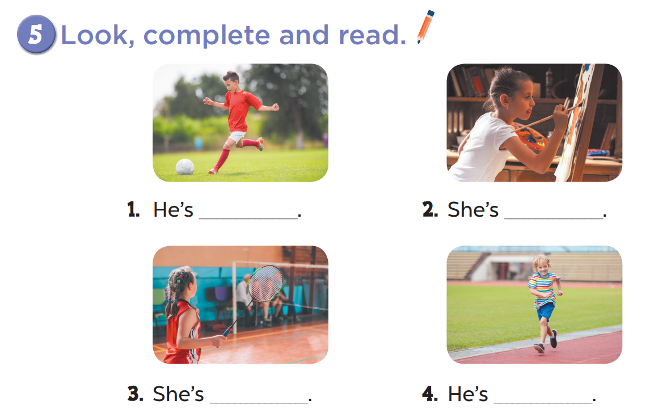
playing football
painting
playing badminton
running

Slide 15
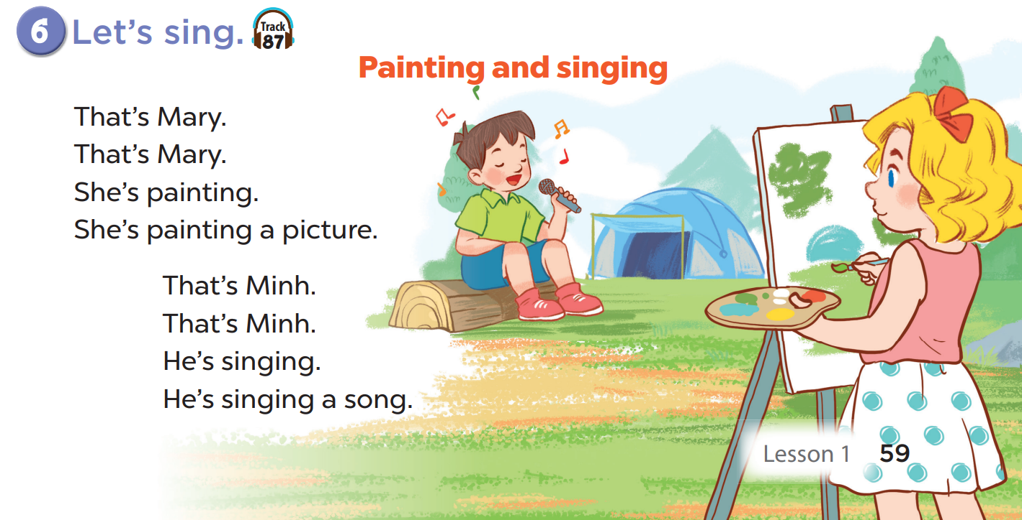

Slide 16










Candy or chilly?
A
B
C
 | A | B | C
1
2
3
+ 50
- 20
Notes:
- Divide the class into 3 teams.
- Each team takes turns picking a square.
- Pupils will get points for each correct question.

Slide 17


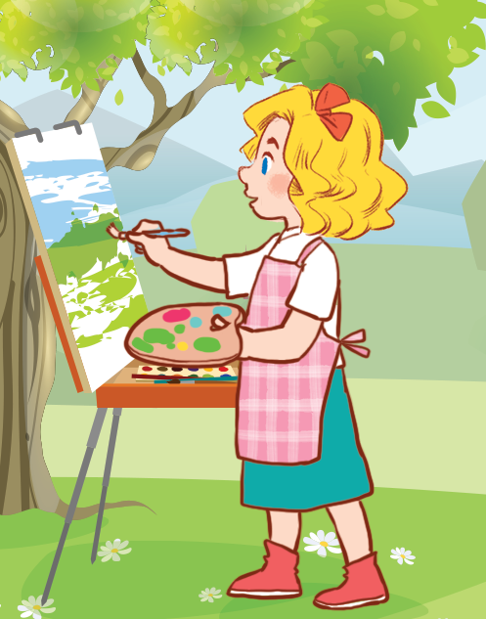
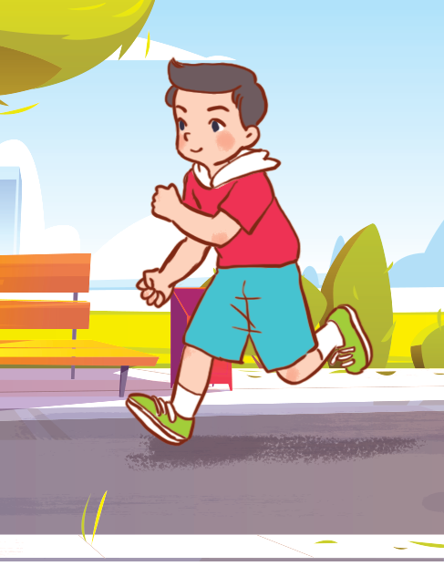
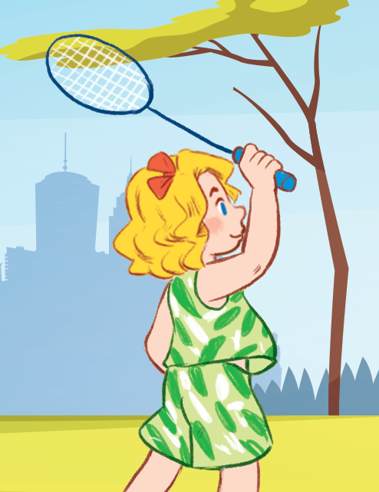
She’s painting.

Slide 18
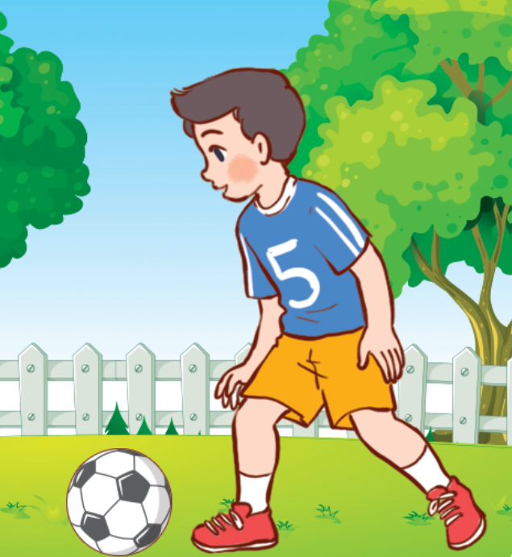
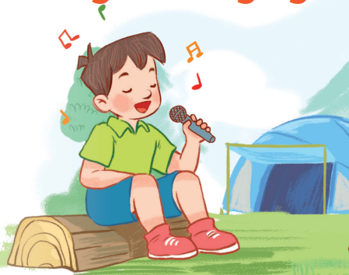
She’s playing badminton.

Slide 19
He’s running.

Slide 20
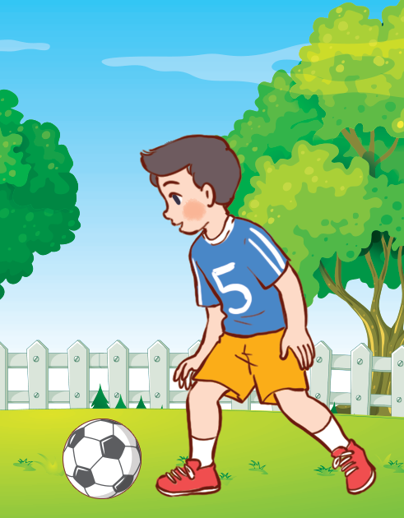
He’s playing football.

Slide 21
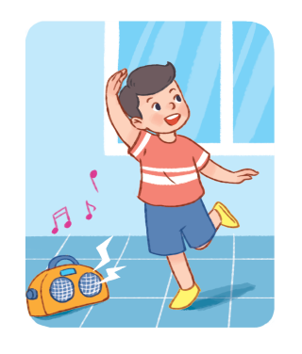
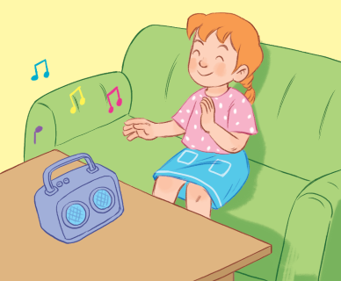
She’s listening to music.

Slide 22
He’s dancing.

Slide 23
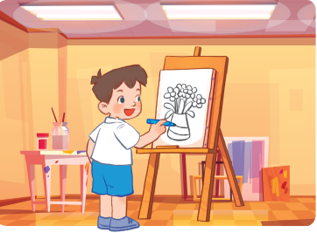
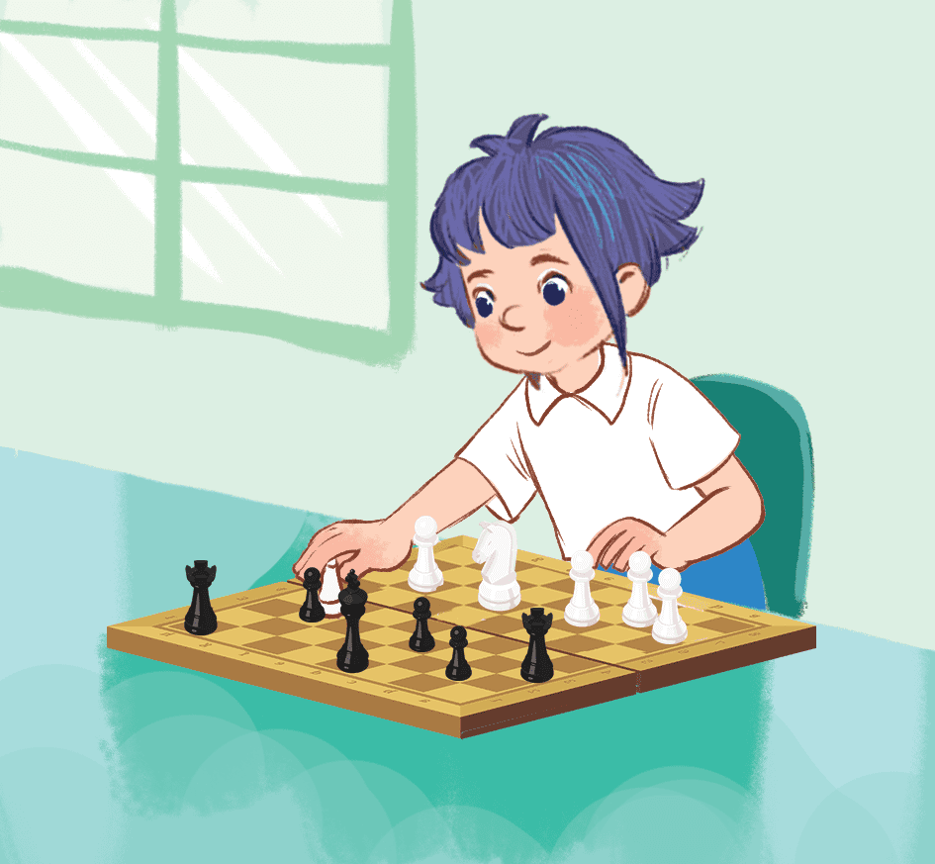
She’s reading a book.

Slide 24
She’s playing chess.

Slide 25
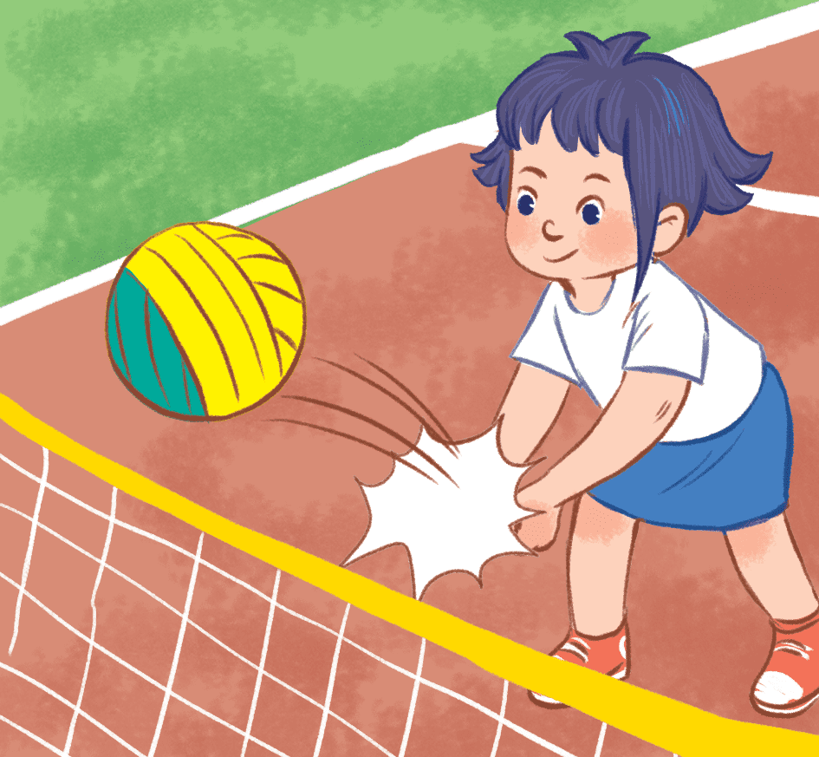
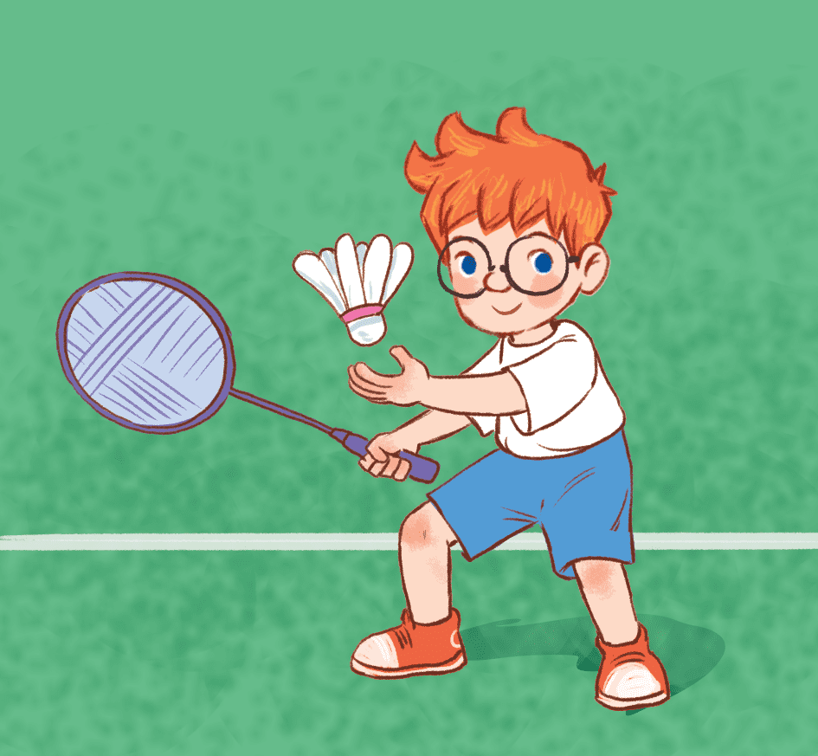
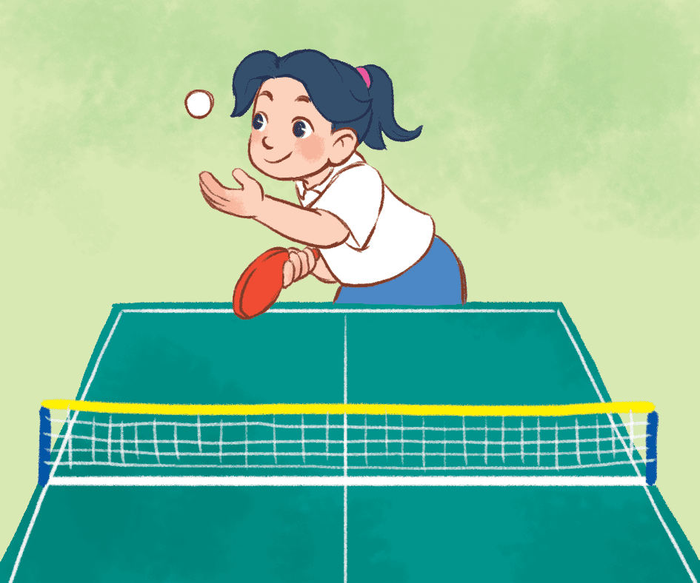
She’s playing volleyball.

Slide 26


Website: sachmem.vn
Fanpage: www.facebook.com/sachmem.vn

