Slide 1



Slide 2



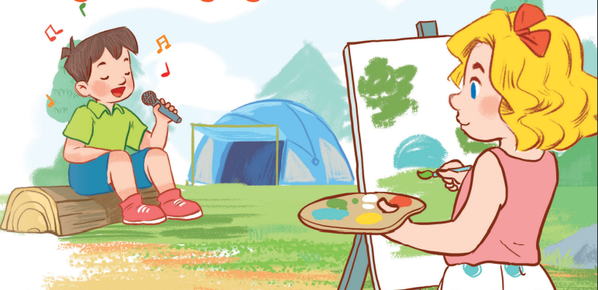
19
Outdoor activities
LESSON 2 – PERIOD 3

Slide 3
Warm-up
& Review
Look, listen
and repeat.
Listen,
point and say.
Let’s talk.
Fun corner
& wrap-up

Slide 4

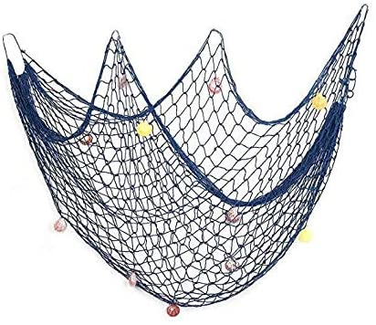
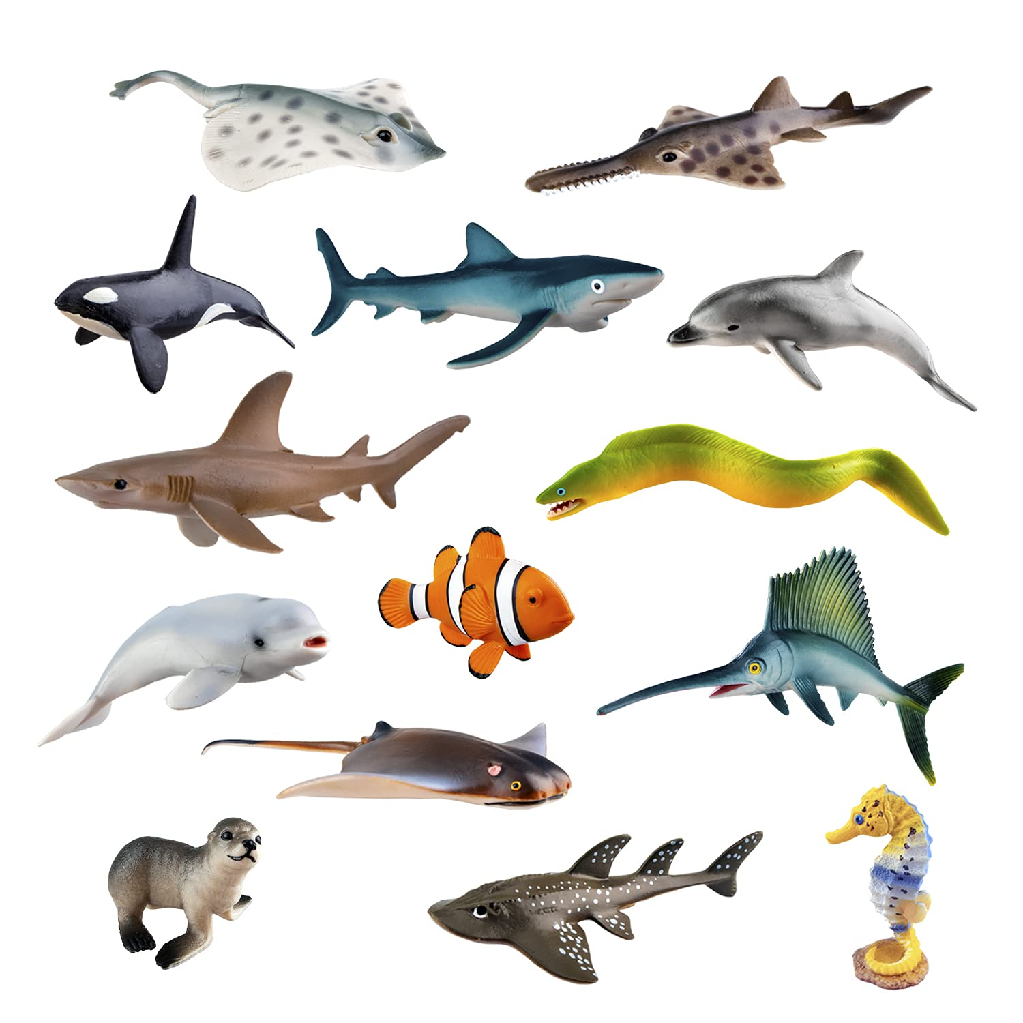
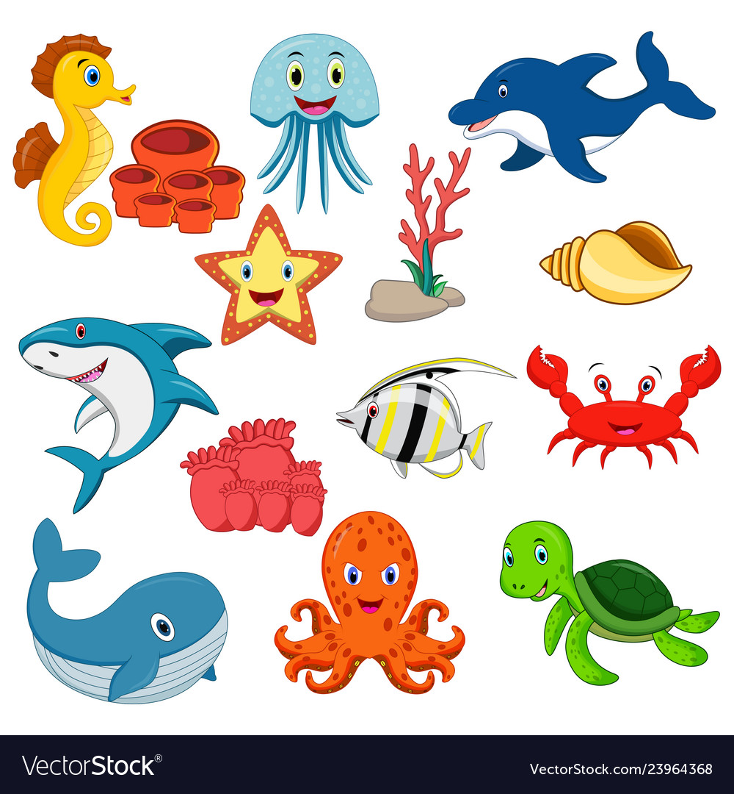
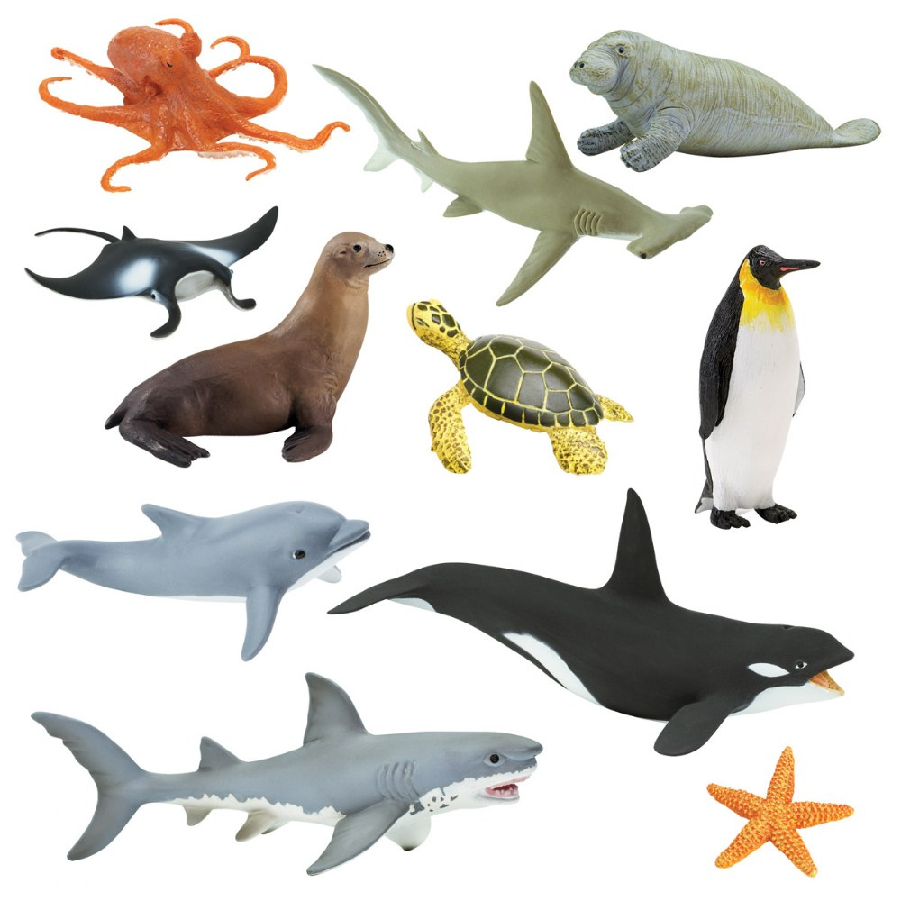

Save the ocean animals.
Warm-up
& Review
BOYS
GIRLS
A
B
C
D
E
F
G
H
Notes:
Click on the letter to go to the questions.
Click on the circle to turn back to the menu.
Click on the animals in the net to release them.

Slide 5

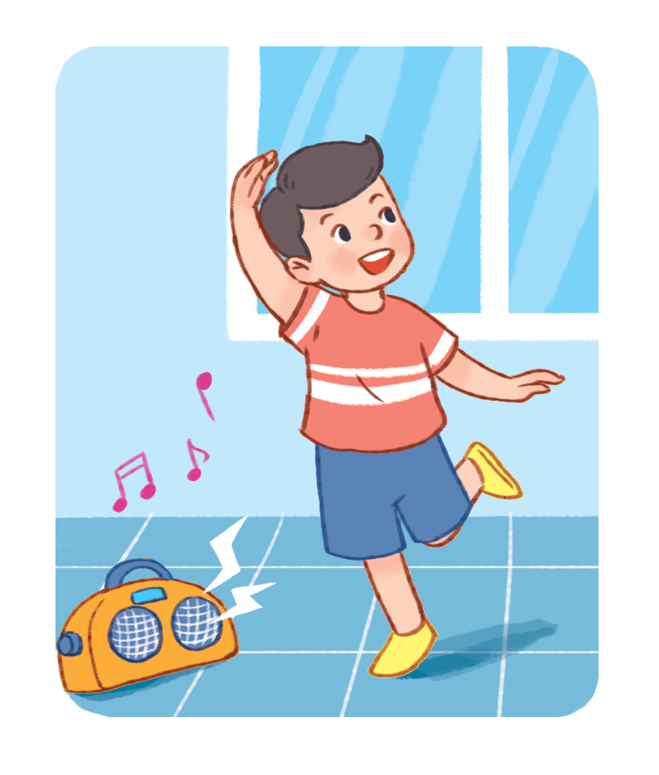

ERROR
ERROR
ERROR
I
She
He
am
am
is
dancing.
singing.
playing.
They
are
playing.
She
is
dancing.
I
am
singing.

Slide 6
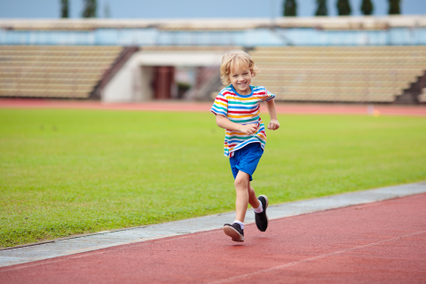
ERROR
ERROR
ERROR
He
She
They
is
am
are
running.
singing.
playing.
He
am
running.
She
is
playing.
They
are
singing.

Slide 7
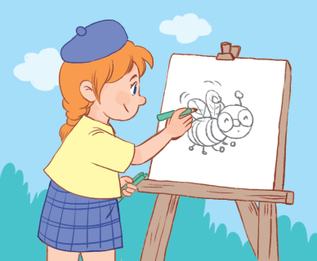
ERROR
ERROR
ERROR
She
He
They
is
am
are
painting.
singing.
reading.
She
am
singing.
He
is
painting.
They
are
reading.

Slide 8
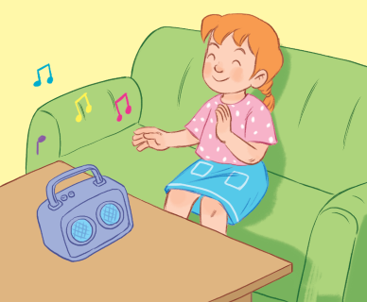
ERROR
ERROR
ERROR
I
She
He
am
am
is
listening to music.
playing chess.
playing volleyball.
He
am
playing volleyball.
They
is
listening to music.
I
are
playing chess.

Slide 9
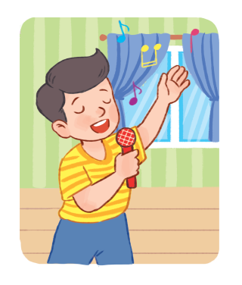
ERROR
ERROR
ERROR
He
She
They
is
am
are
singing.
singing.
playing.
He
am
singing.
She
is
playing.
They
are
running.

Slide 10

ERROR
ERROR
ERROR
She
He
They
is
am
are
reading.
singing.
dancing.
She
am
singing.
He
is
reading.
They
are
dancing.

Slide 11
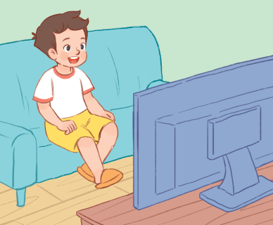
ERROR
ERROR
ERROR
He
She
They
is
am
are
watching TV.
reading a book.
playing games.
He
am
watching TV.
She
is
playing games.
They
are
reading a book.

Slide 12

ERROR
ERROR
ERROR
She
He
They
is
am
are
walking.
running.
jumping.
She
am
running.
He
is
walking.
They
are
jumping.

Slide 13

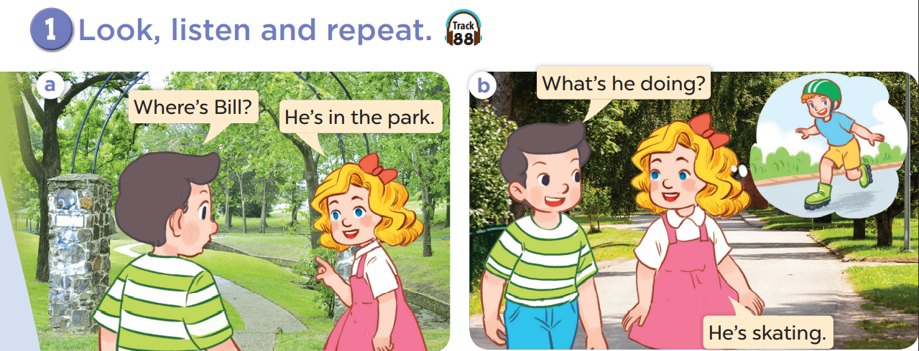


Slide 14
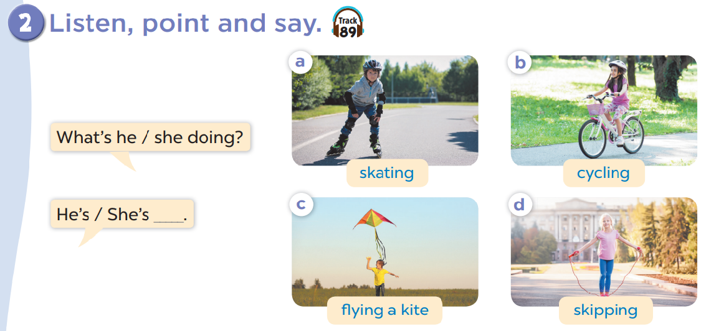

Slide 15
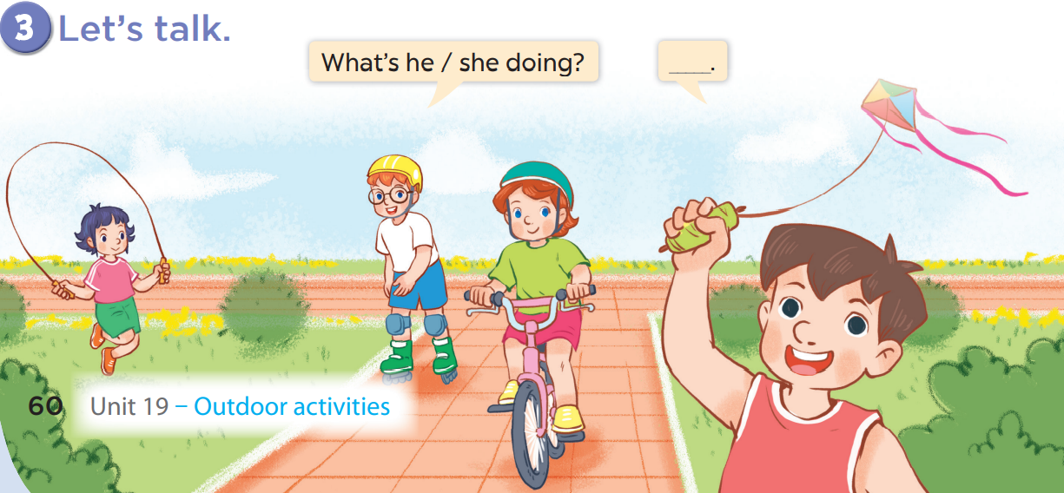

Slide 16
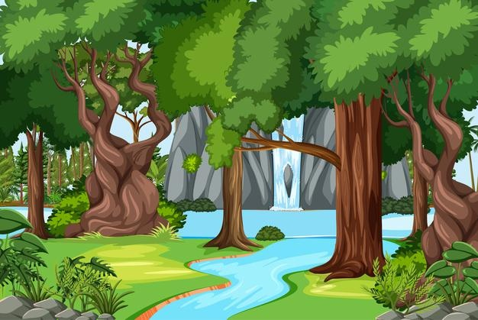


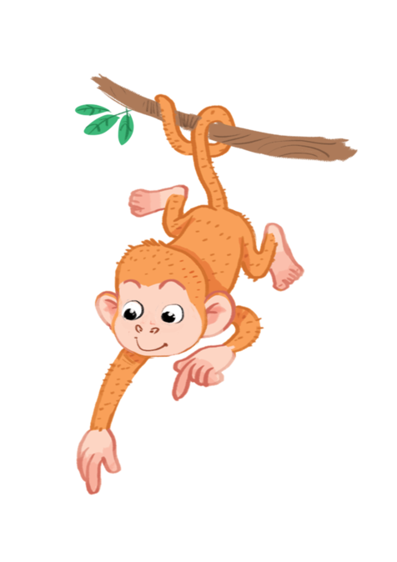


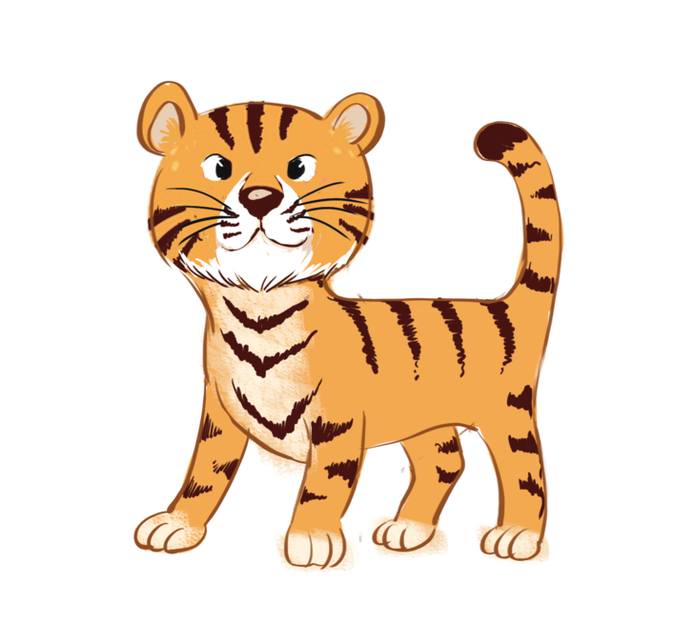
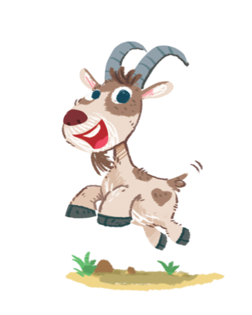





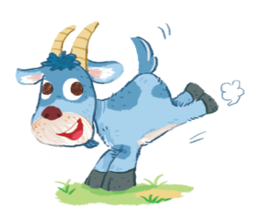


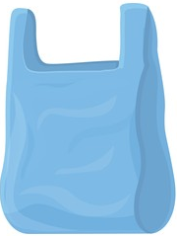



Let’s clean up!
Notes:
https://www.google.com/search?q=wood+and+stream+cartoon&tbm=isch&ved=2ahUKEwjK3_jepMj1AhUM_5QKHdlrCRUQ2-cCegQIABAA&oq=wood+and+stream+cartoon&gs_lcp=CgNpbWcQAzoHCCMQ7wMQJzoECAAQE1CoB1jzMGDRNWgFcAB4AoABSogBuQaSAQIxMpgBAKABAaoBC2d3cy13aXotaW1nwAEB&sclient=img&ei=aIHtYcqLJIz-0wTZ16WoAQ&bih=937&biw=1920#imgrc=GSA89GEHO_5-LM&imgdii=0AdJe6_1jZm6EM

Slide 17





What’s he doing?
A. He’s dancing.
B. He’s singing.
C. He’s running.

Slide 18
What’s she doing?
A. She’s dancing.
B. She’s running.
C. She’s walking.

Slide 19

What’s he doing?
A. He’s walking.
B. He’s running.
C. He’s skating.

Slide 20
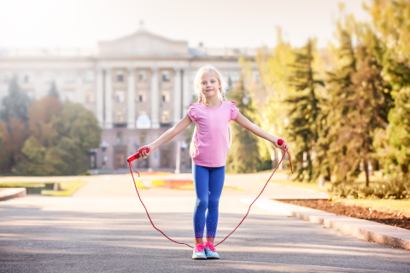
What’s she doing?
A. She’s skating.
B. She’s running.
C. She’s skipping.

Slide 21
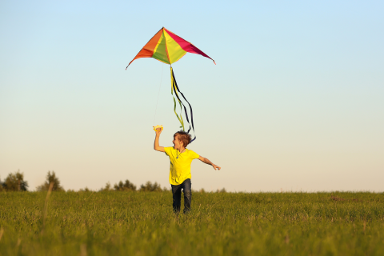
What’s he doing?
A. He’s skating.
B. He’s flying a kite.
C. He’s cycling.

Slide 22
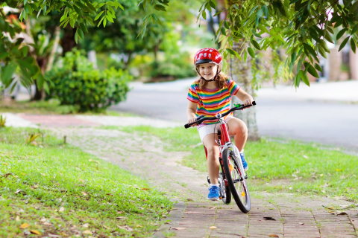
What’s she doing?
A. She’s skipping.
B. She’s skating.
C. She’s cycling.

Slide 23
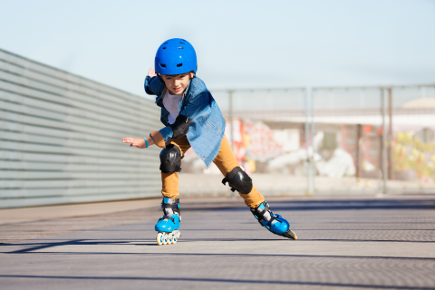
What’s he doing?
A. He’s cycling.
B. He’s skating.
C. He’s skipping.

Slide 24
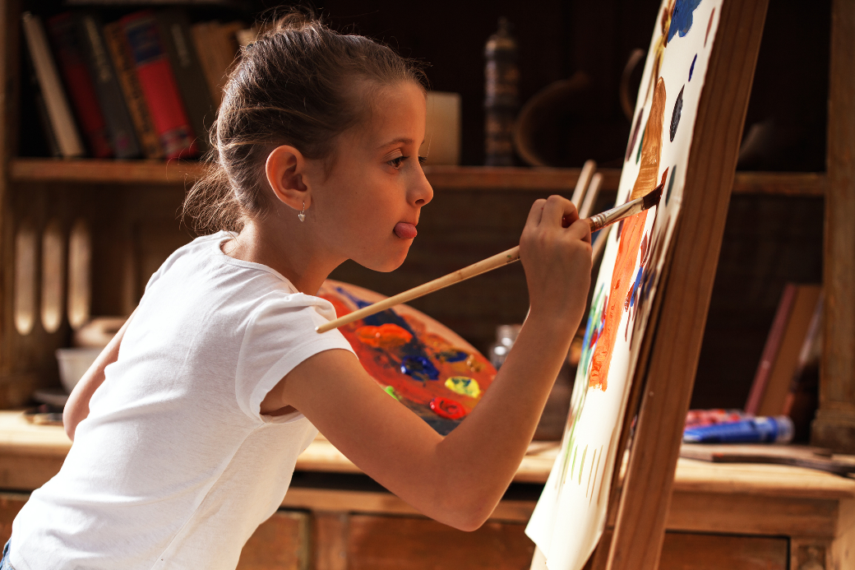
What’s she doing?
A. She’s painting.
B. She’s cycling.
C. She’s skipping.

Slide 25


Website: sachmem.vn
Fanpage: www.facebook.com/sachmem.vn

