Slide 1



Slide 2



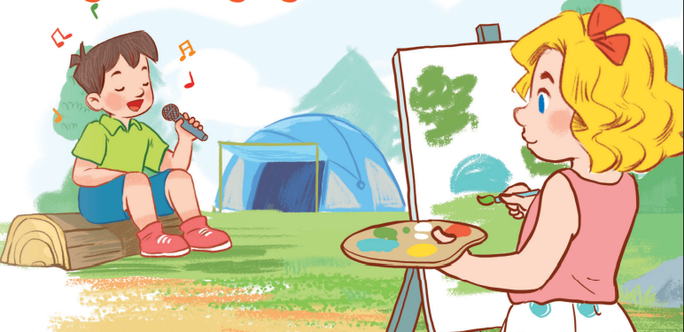
19
Outdoor activities
LESSON 2 – PERIOD 4

Slide 3
Warm-up
& Review
Listen
and number.
Look,
complete
and read.
Let’s play.
Fun corner
& wrap-up

Slide 4











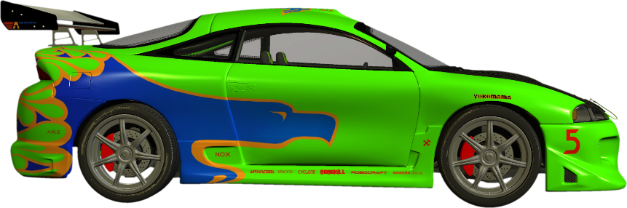

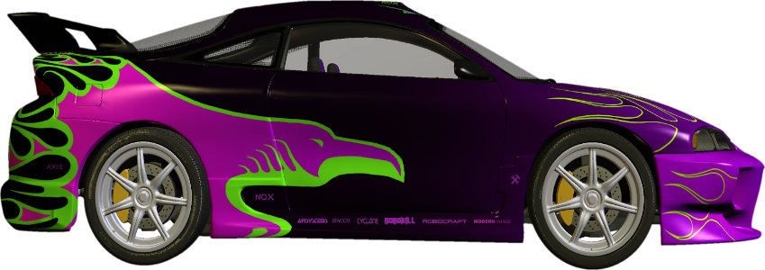
CAR RACING
Click to make the green car move
Click to make the purple car move

Slide 5



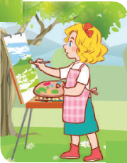
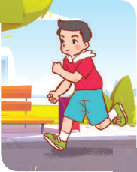
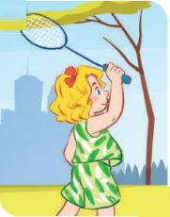
Listen and choose.
Notes:
Click on teachers once to listen to the conversation and choose the right picture.

Slide 6

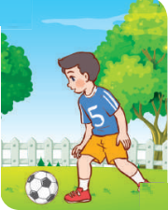
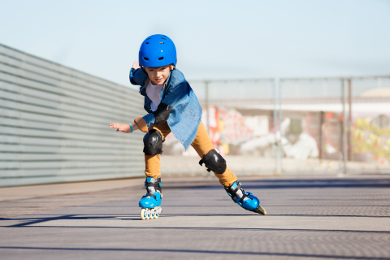

Listen and choose.

Slide 7
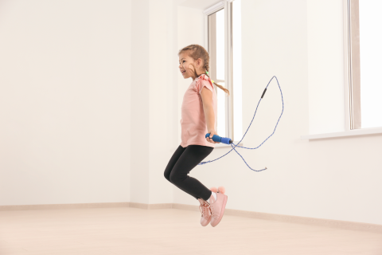
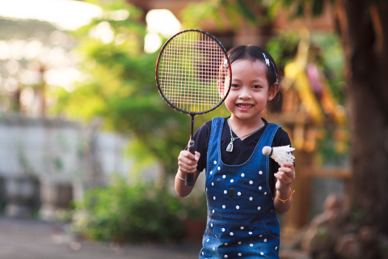
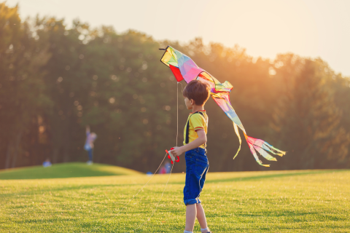
Listen and choose.

Slide 8
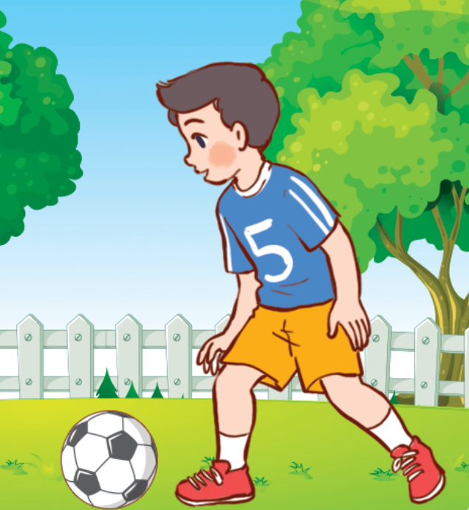
Listen and choose.

Slide 9
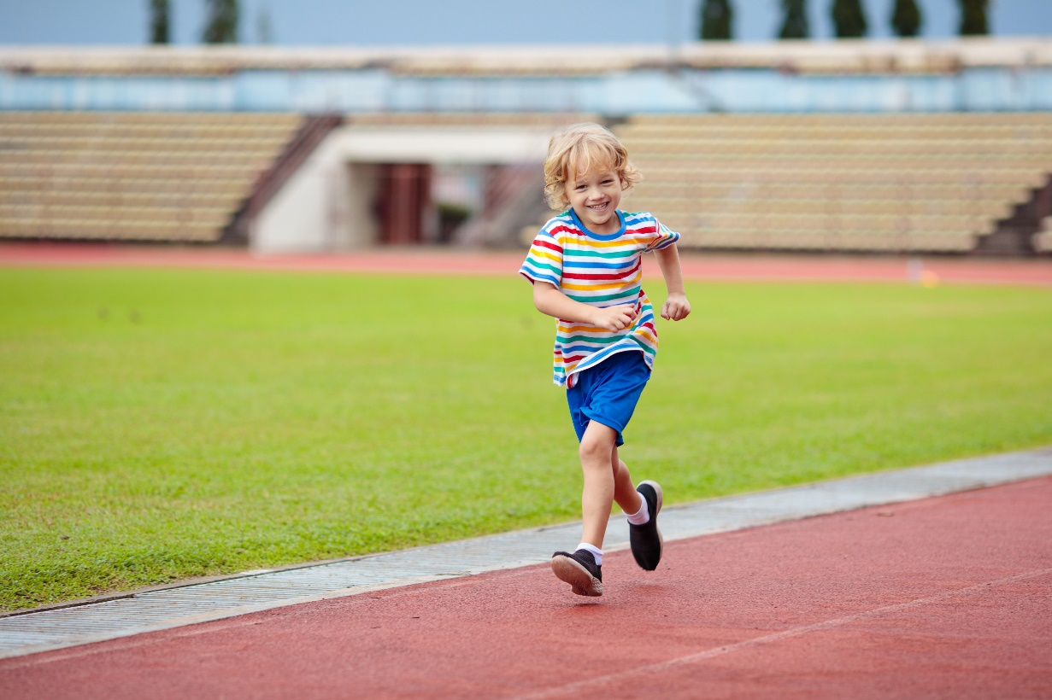
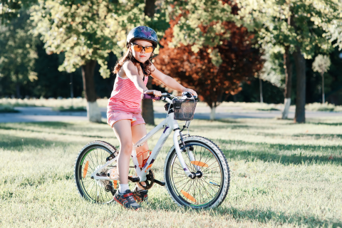
Listen and choose.

Slide 10

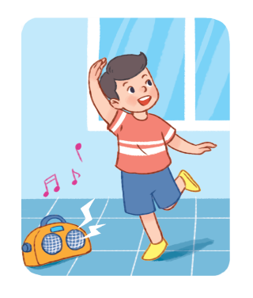
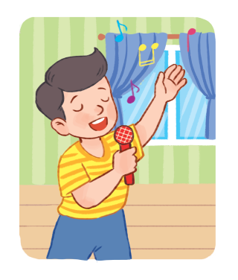
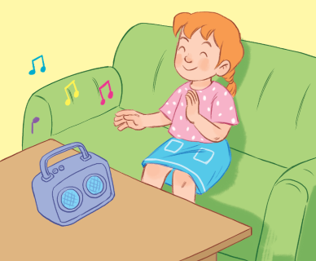
Listen and choose.

Slide 11
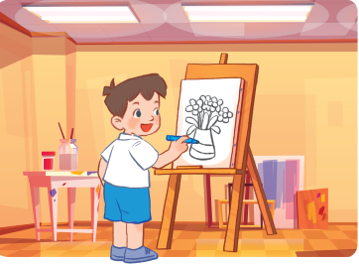

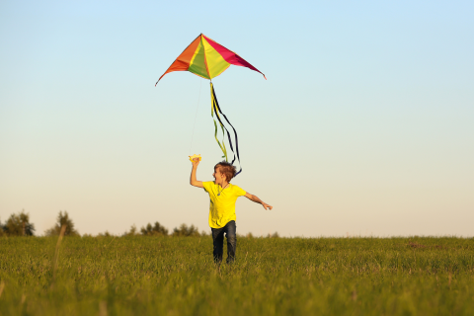
Listen and choose.

Slide 12
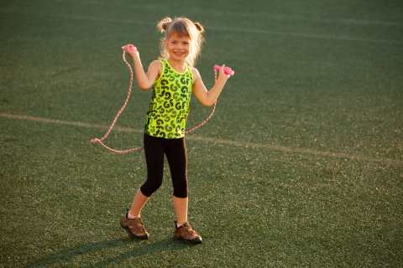

Listen and choose.

Slide 13

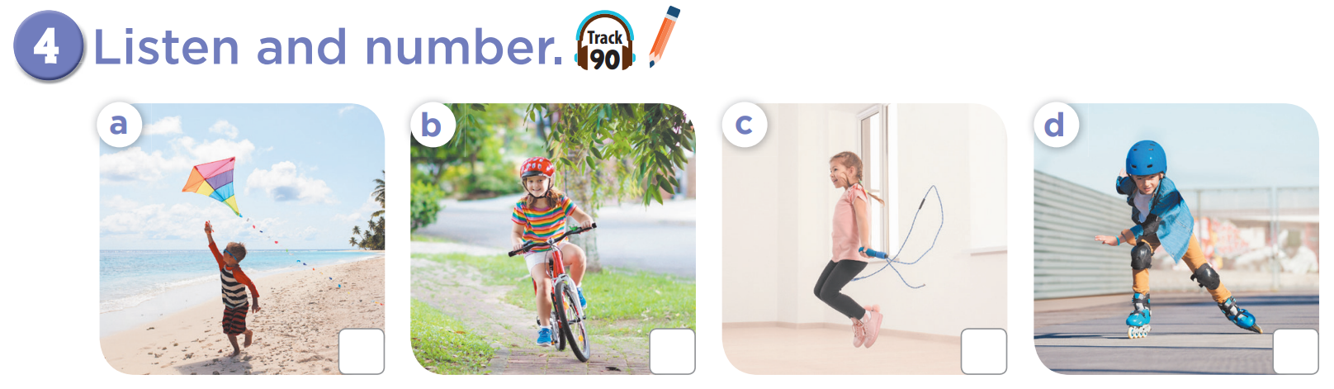
2
3
4
1

Slide 14
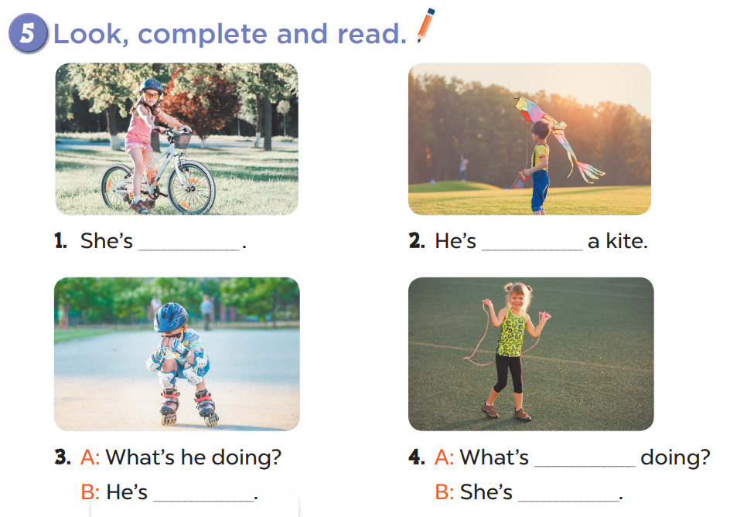
cycling
flying
she
skating
skipping

Slide 15
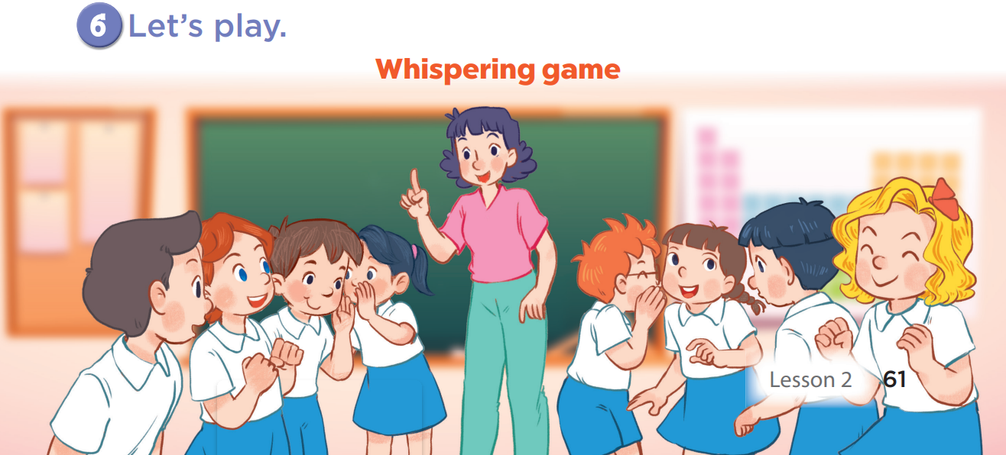

Slide 16


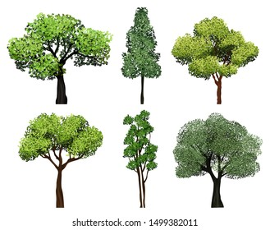

Green Earth
Team A
Team B
1
2
3
4
5
6
7
8
Notes:
Click on the numbers to go to the questions.
Click on the home icon to turn back to the menu.
Click on the trees to grow trees for the Earth.

Slide 17
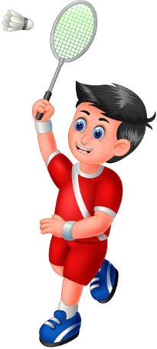
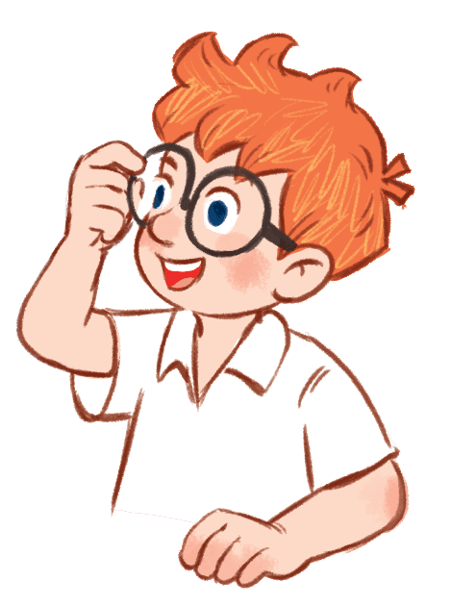
What’s he doing?
He’s playing badminton.
Notes:
Let pupils look and guess what people are doing.

Slide 18
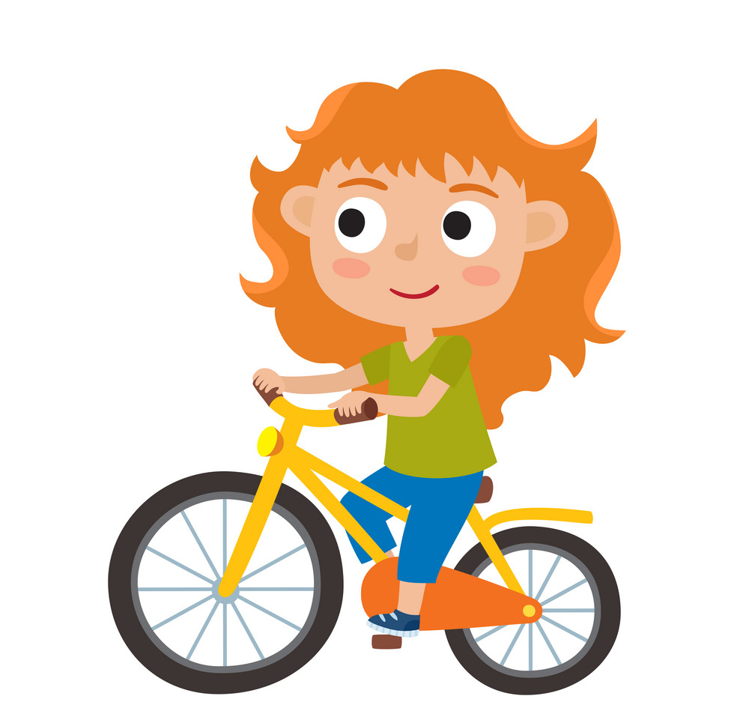
What’s she doing?
She’s cycling.

Slide 19
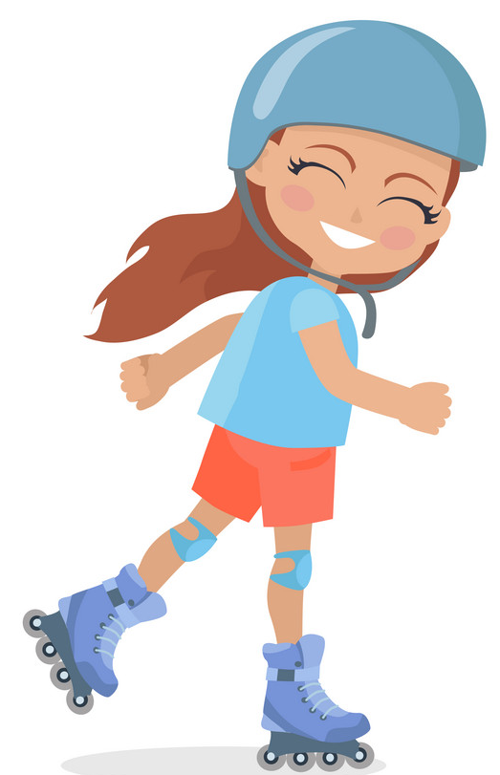
What’s she doing?
She’s skating.

Slide 20
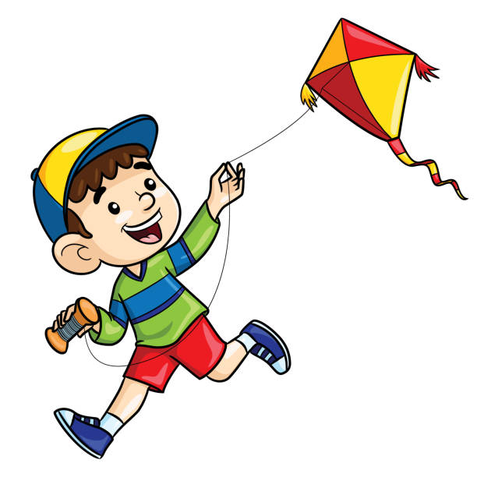
What’s he doing?
He’s flying a kite.

Slide 21

What’s she doing?
She’s walking.

Slide 22

What’s she doing?
She’s skipping.

Slide 23
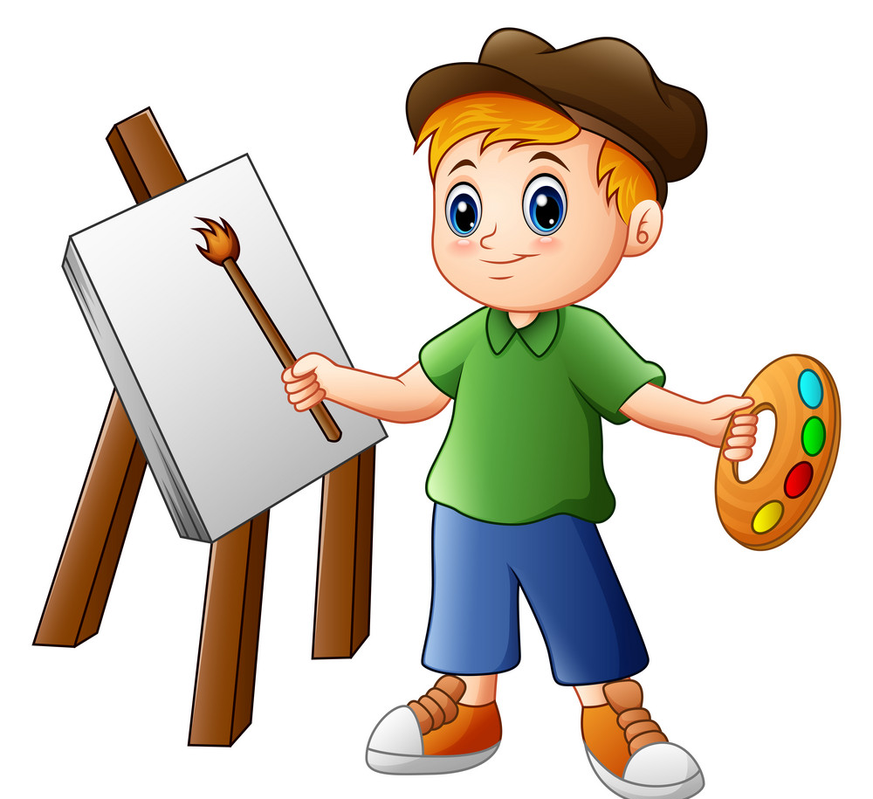
What’s he doing?
He’s painting.

Slide 24
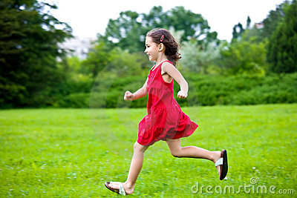
What’s she doing?
She’s running.

Slide 25


Website: sachmem.vn
Fanpage: www.facebook.com/sachmem.vn

