Slide 1



Slide 2



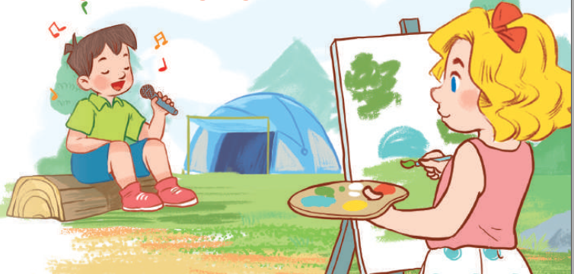
19
Outdoor activities
LESSON 3 – PERIOD 6

Slide 3
Warm-up
& Review
Read
and answer.
Let’s write.
Project
Fun corner
& wrap-up

Slide 4

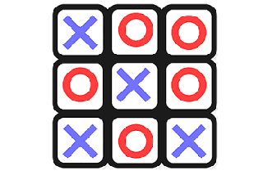

TIC TAC TOE

Slide 5

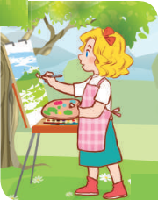
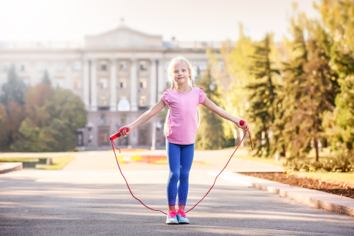
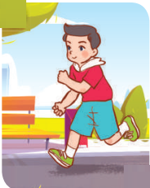


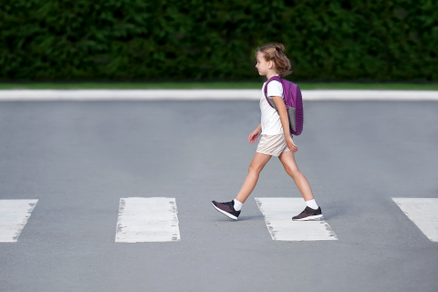
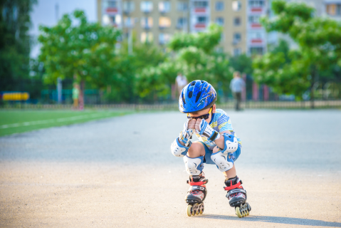
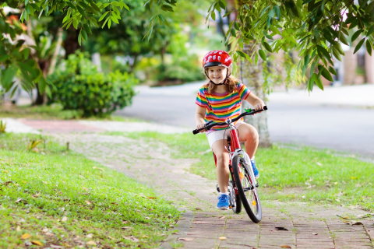
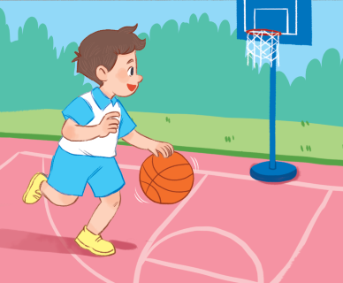
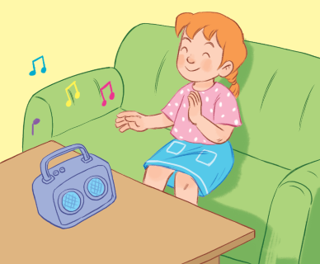
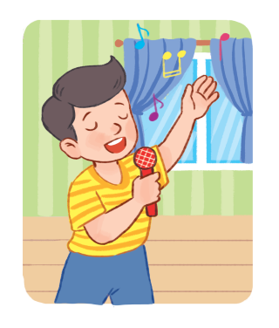
Choose and say!
What’s he/she doing?
A
B
C
1
2
3

Slide 6


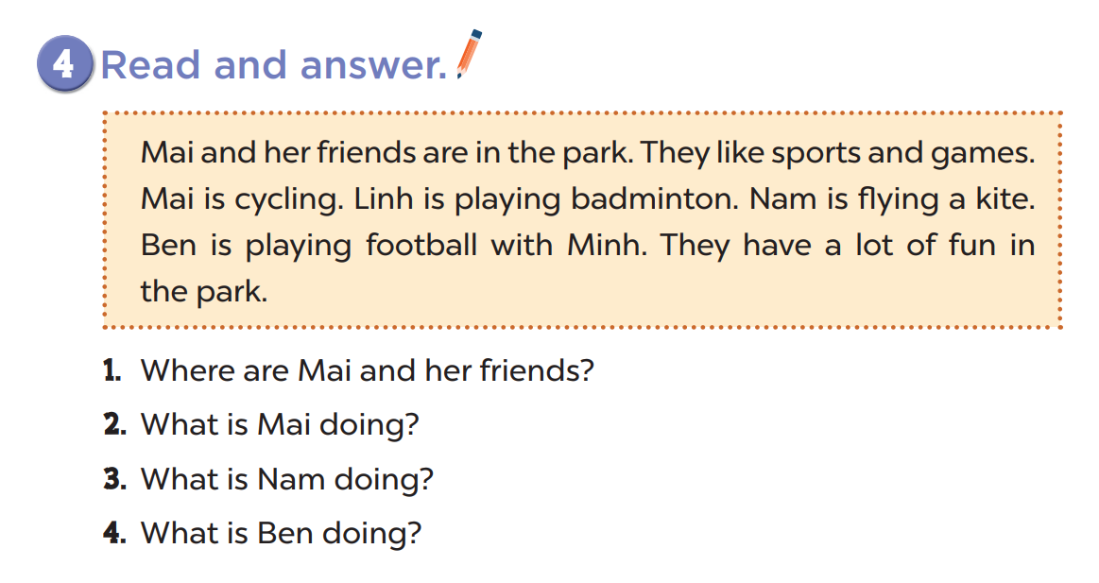
They’re in the park.
She’s cycling.
He’s flying a kite.
He’s playing football.

Slide 7
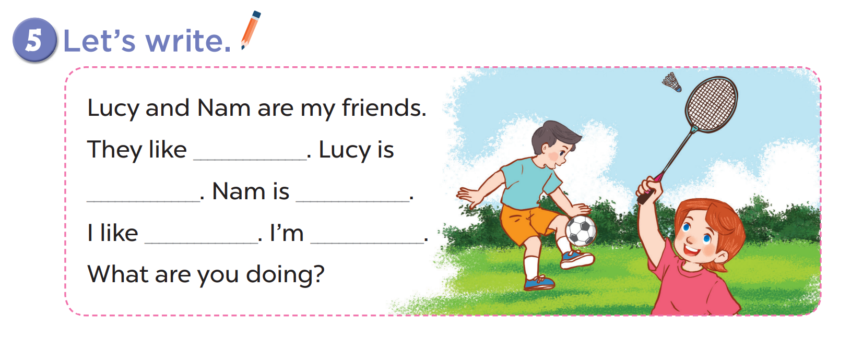

Slide 8
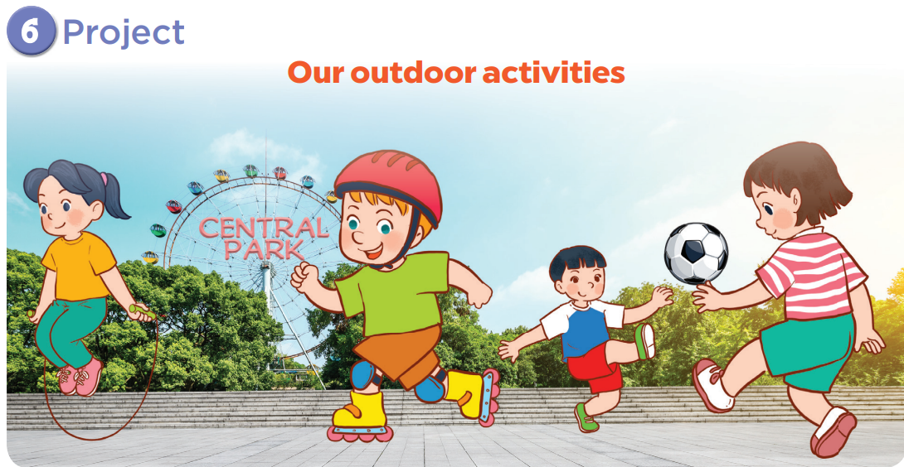

Slide 9

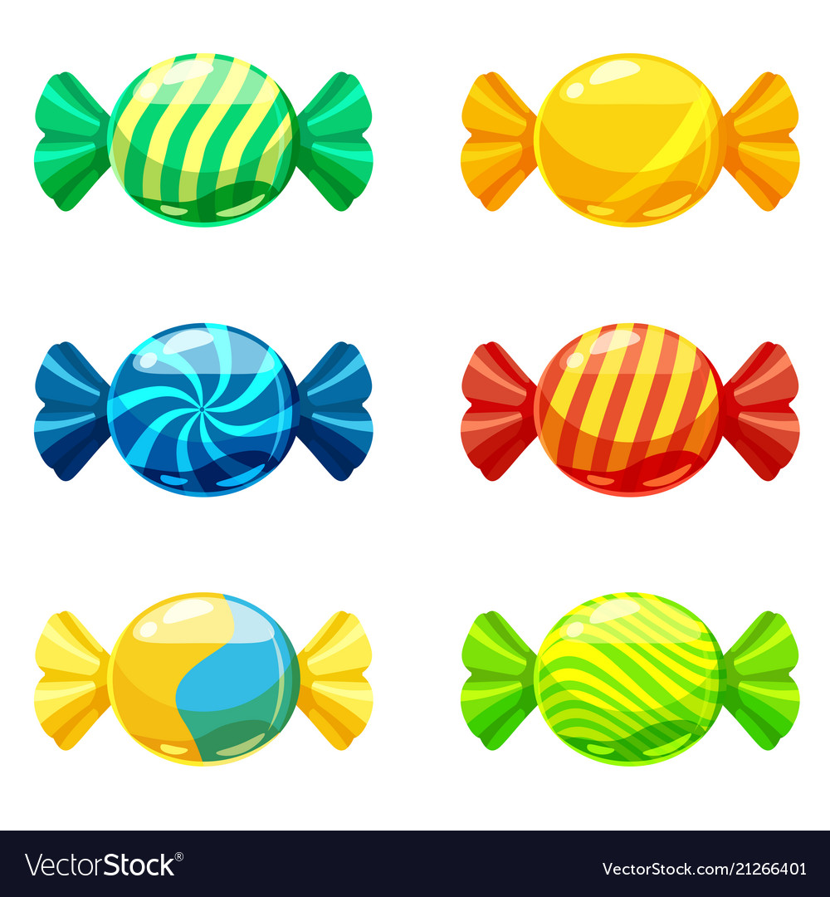
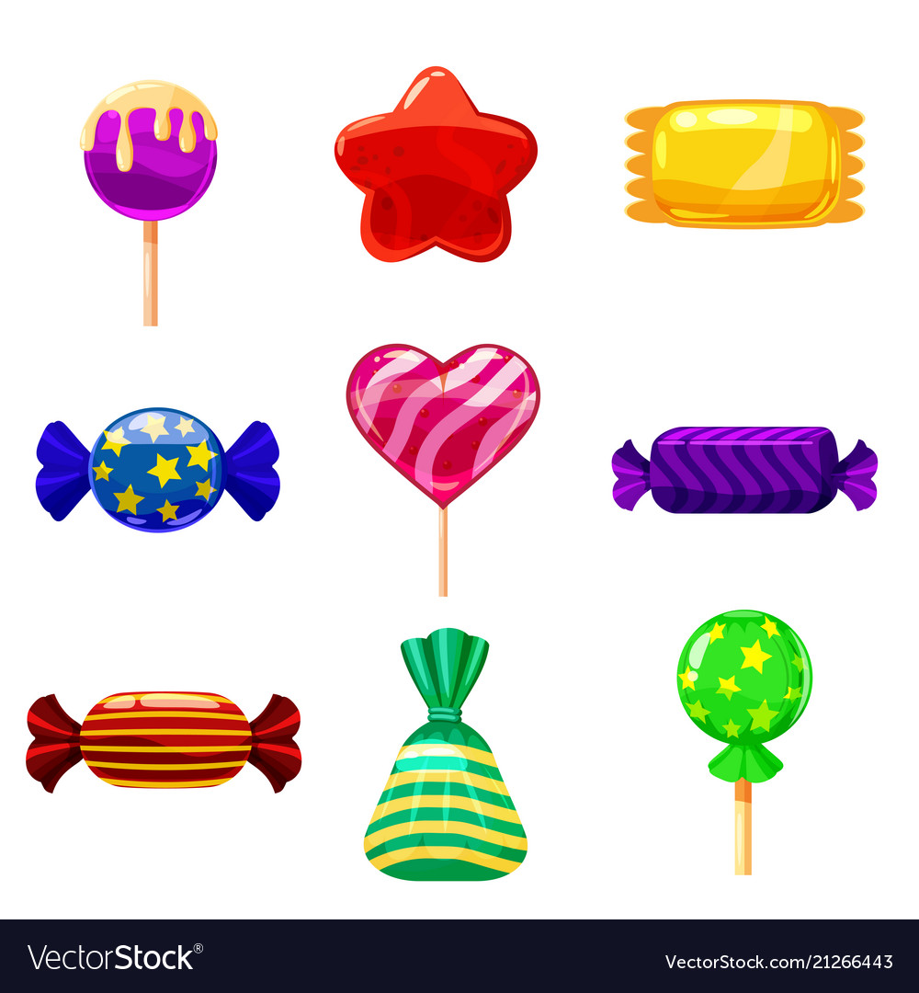

TEAM A
TEAM B
0
1
2
3
4
5
6
7
8
9
0
1
2
3
4
5
6
7
8
9
0
1
2
3
4
5
6
7
8
0
9
1
2
3
4
5
6
7
8
9
0
1
2
3
4
5
6
7
8
9
0
1
2
3
4
5
6
7
8
9
CANDY OR LIGHTENING

Slide 10
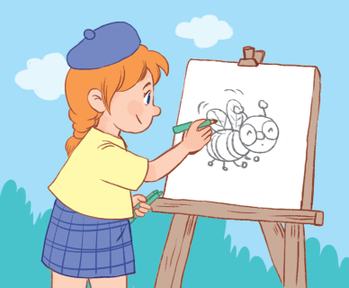




What are you doing?
30
reading
am
20
is
writing
are
painting
“I ____ __________
a bee.”
am
painting

Slide 11
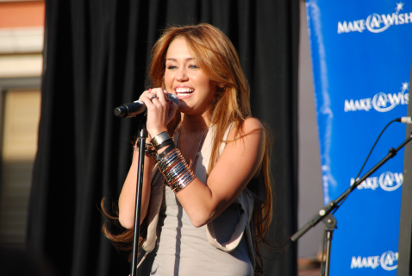
What’s she doing?
am
20
dancing
40
is
singing
are
watching TV
She ____ __________
at the party.
is
singing

Slide 12
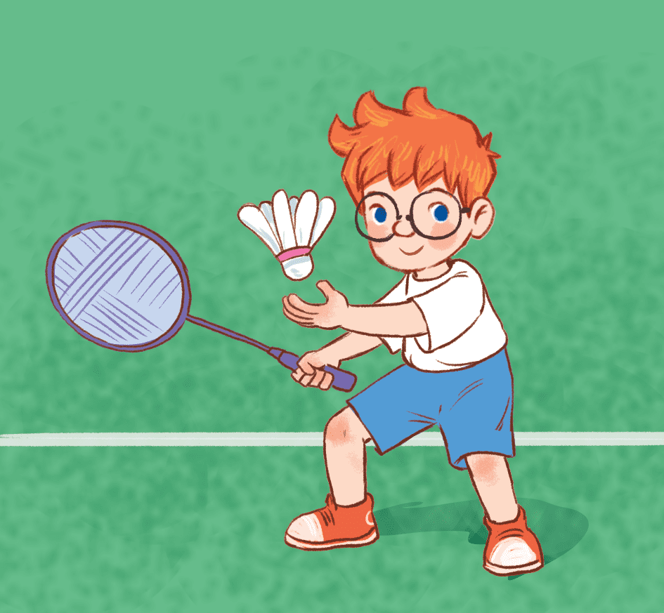
What’s he doing?
am
10
30
playing football
is
playing badminton
are
playing games
He ____ __________
in the park.
is
playing badminton

Slide 13
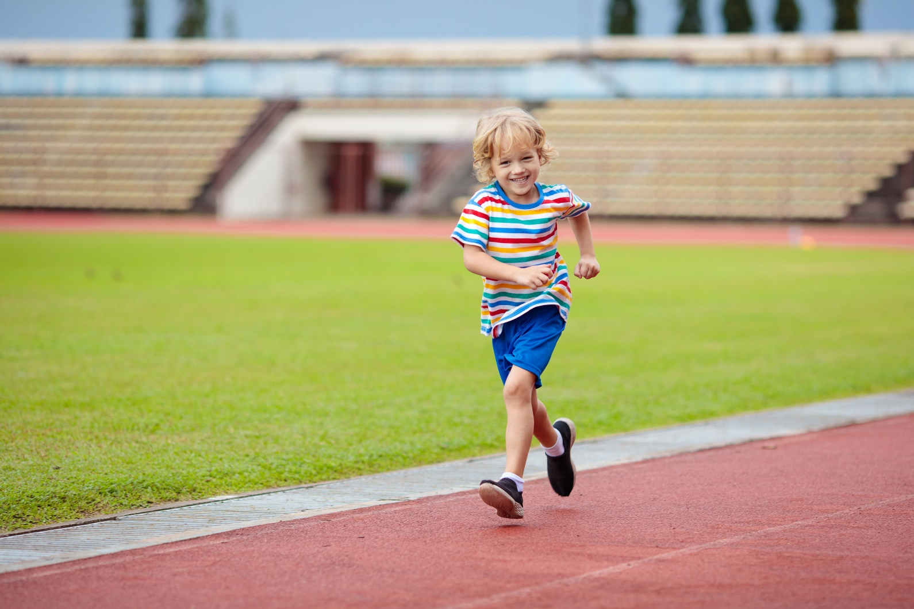
What’s he doing?
am
50
running
10
is
walking
are
skipping
He ____ __________ .
is
running

Slide 14
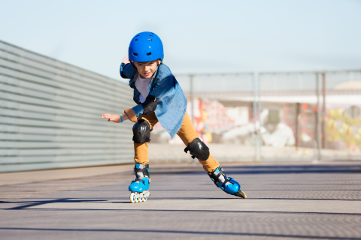
What are you doing?
20
listening to music
am
30
flying a kite
is
skating
are
“I ____ __________
in the rink.”
am
skating

Slide 15
What’s she doing?
am
20
running
40
is
skipping
are
cycling
She ____ __________
in the playground.
is
cycling

Slide 16
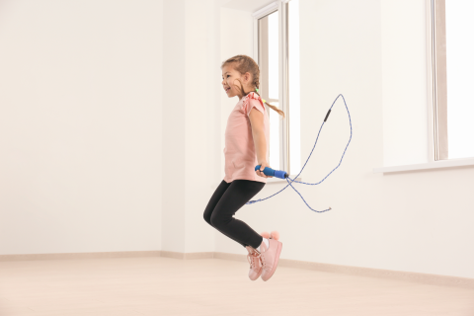
What are you doing?
10
am
50
skipping
is
cycling
are
singing
“I ____ __________ .”
am
skipping

Slide 17
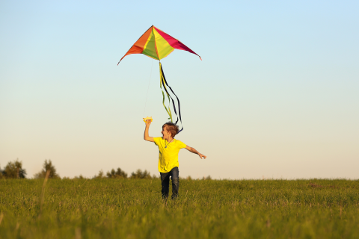
What’s he doing?
am
40
20
watching TV
is
walking
are
flying a kite
He ____ __________
in the field.
is
flying a kite

Slide 18

tienganh.sachmem.vn

